Slide 1

RAS
1ST
WS

Slide 2
RAS
1ST
WS
IN COLLABORATION WITH
Computer Society
(CS)

Slide 3
RAS
1ST
WS
Hello!

Slide 4
ROBOTICS & AUTOMATION
BVPIEEE
Robotics and Automation Society (RAS)

Slide 5
Differential Drive
DD
My First Bot
Notes:
Tank
No steering / fixed wheels

Slide 6
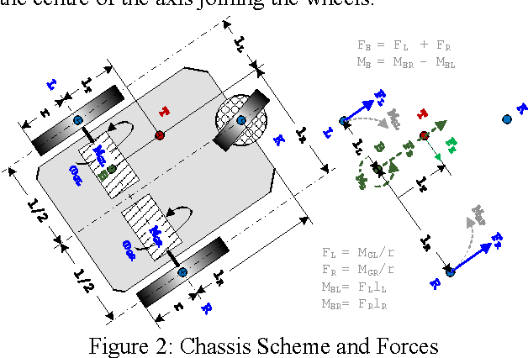
DD
Notes:
JK … SKIP TO NEXT SLIDE

Slide 7
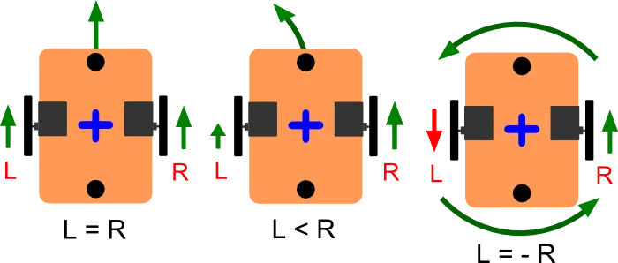
DD

Slide 8
Back To Basics

Slide 9

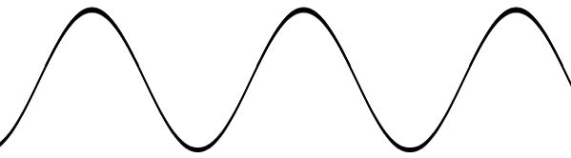
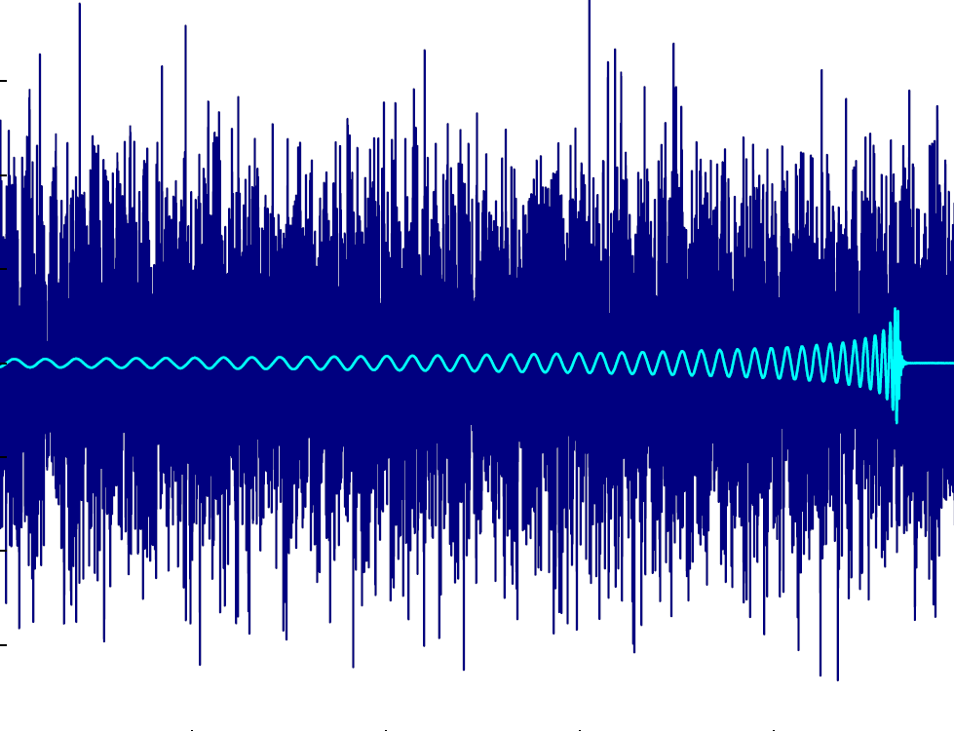
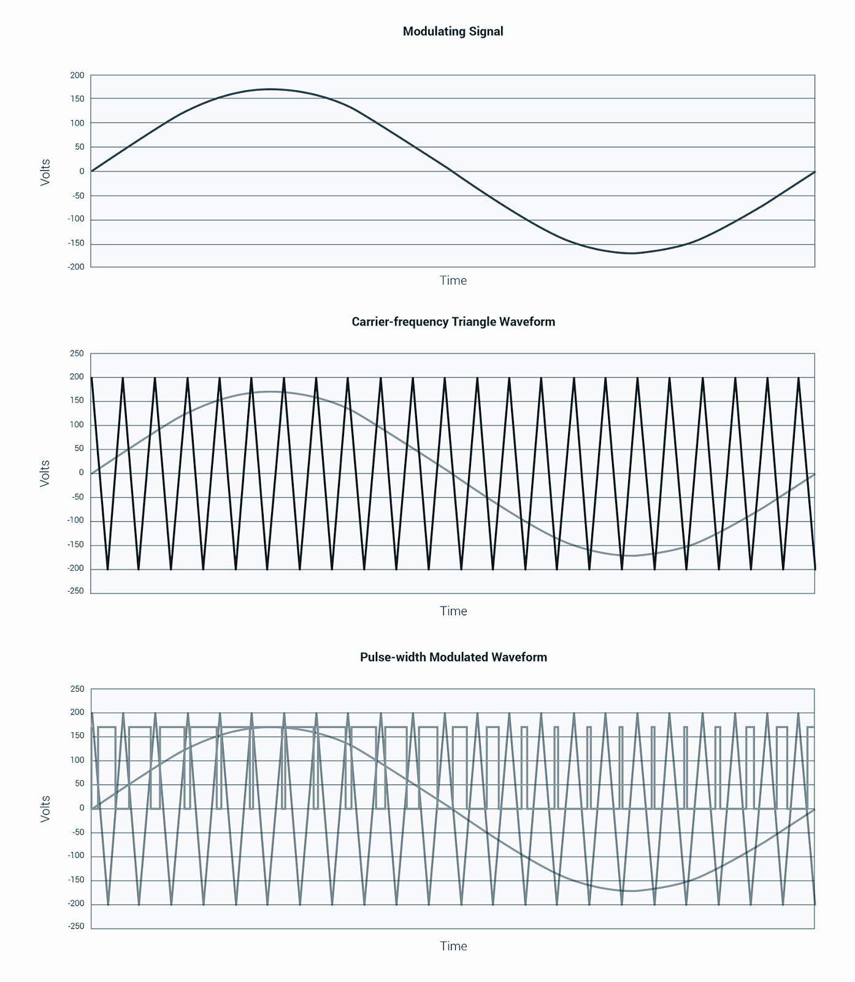
Signals
Definition
Types

Slide 10
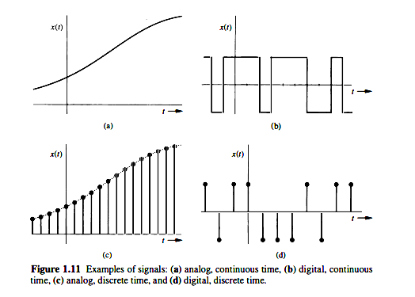

Slide 11
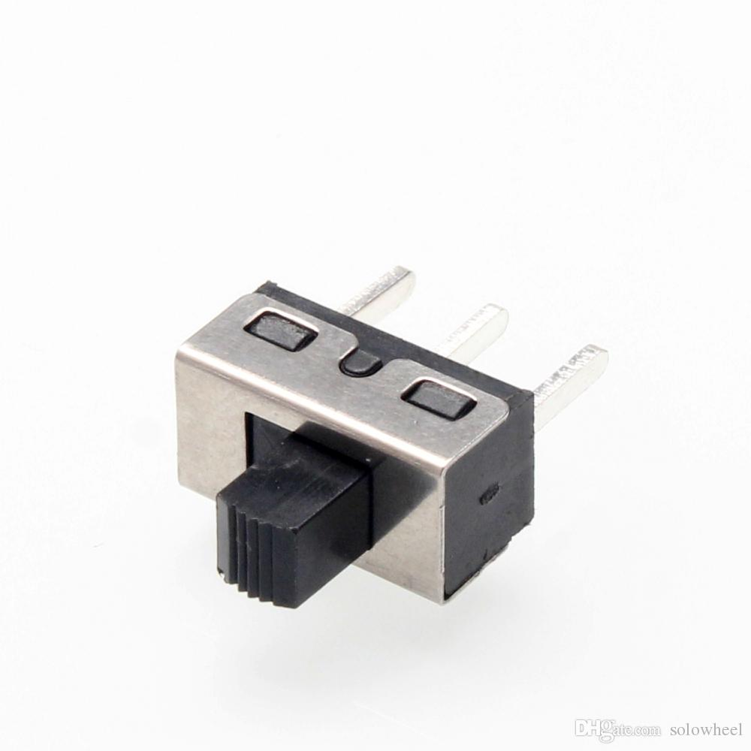
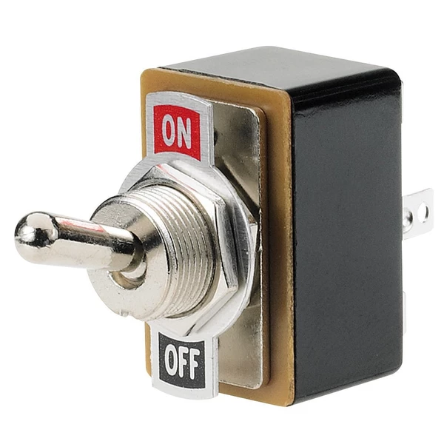
Switches
Definition
Types
Notes:
A switch is a component which controls the open-ness or closed-ness of an electric circuit. They allow control over current flow in a circuit

Slide 12
Switches
Definition
Types
SPST
SPDT
DPDT
Notes:
A switch is a component which controls the open-ness or closed-ness of an electric circuit. They allow control over current flow in a circuit

Slide 13
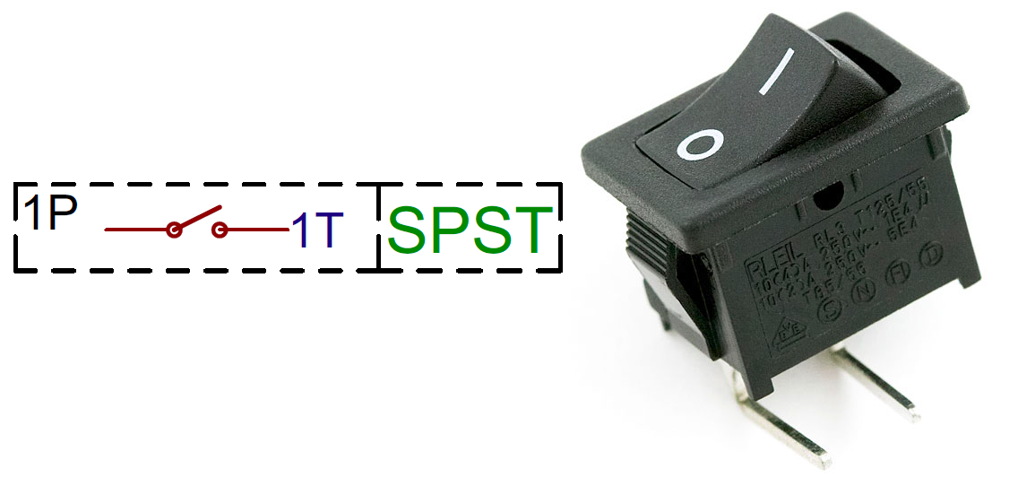
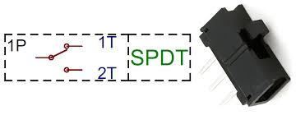
Single Pole Single Throw
(SPST)

Slide 14
Single Pole Double
Throw
(SPDT)

Slide 15
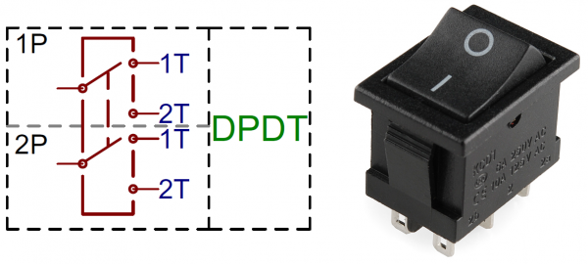
Double Pole Double Throw
(SPDT)

Slide 16
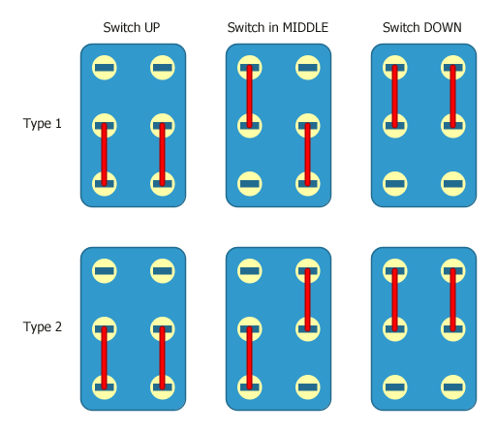
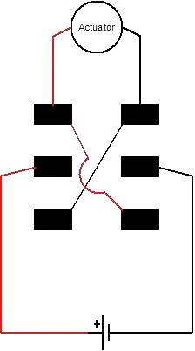

Slide 17
Actuators
Let's get moving

Slide 18
Motors
Definition
Types
Notes:
A switch is a component which controls the open-ness or closed-ness of an electric circuit. They allow control over current flow in a circuit

Slide 19
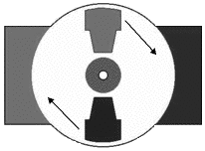
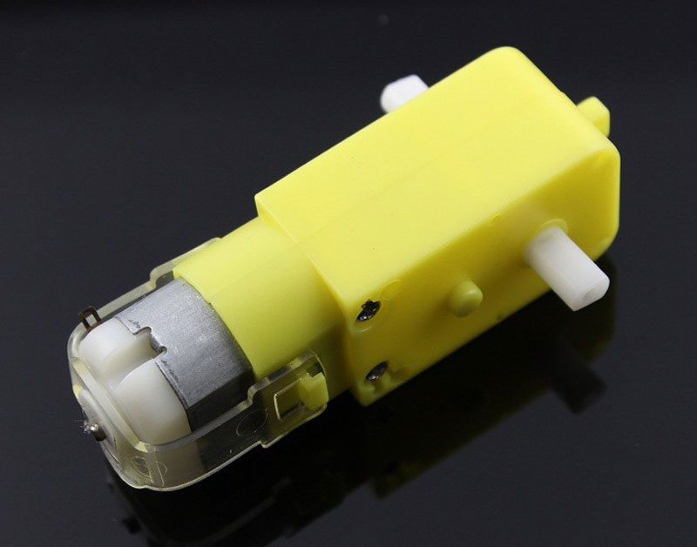
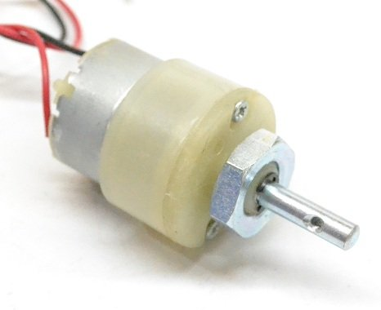
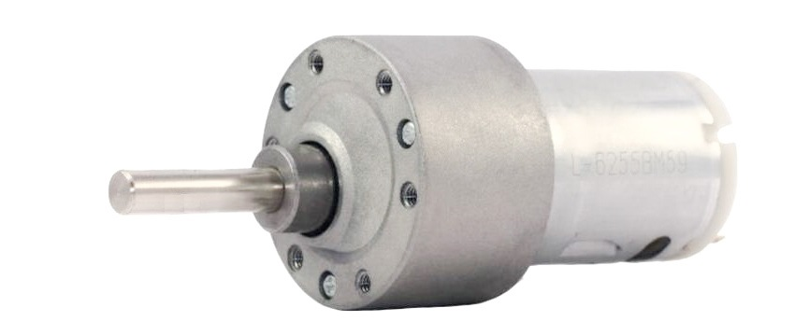
DC Motors

Slide 20
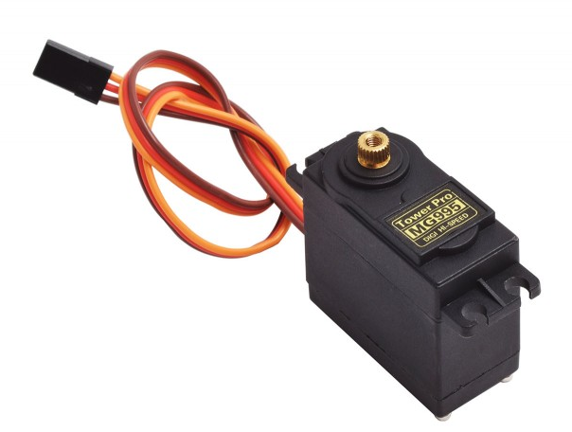
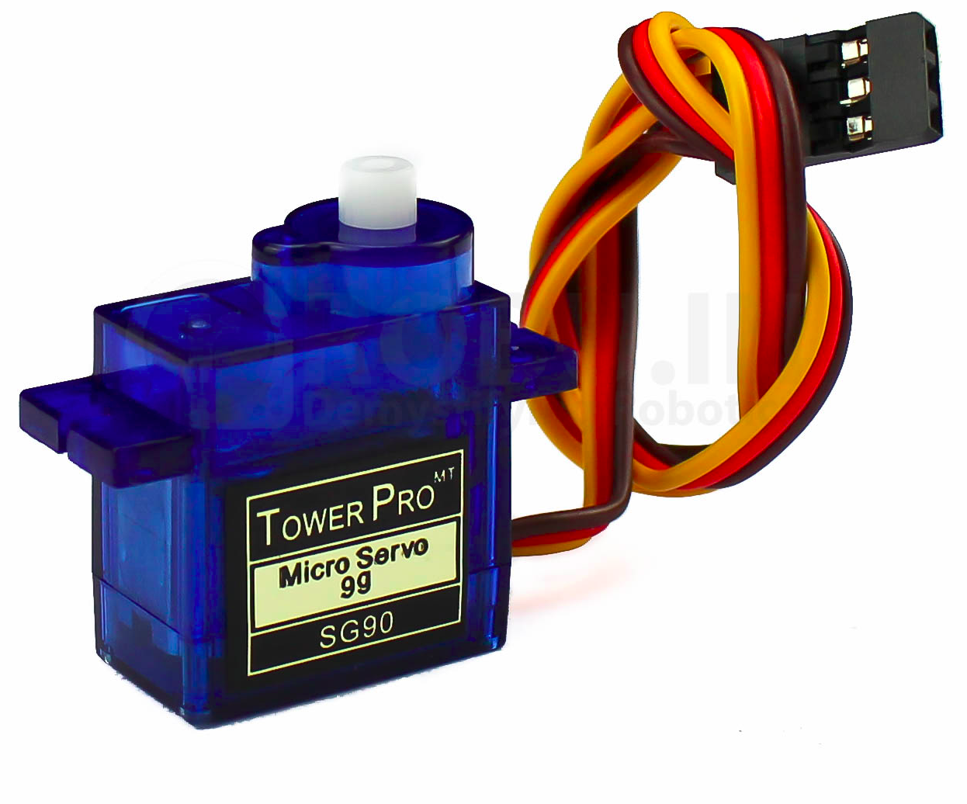
Servo Motors
Notes:
VIDEO SHOWN

Slide 21
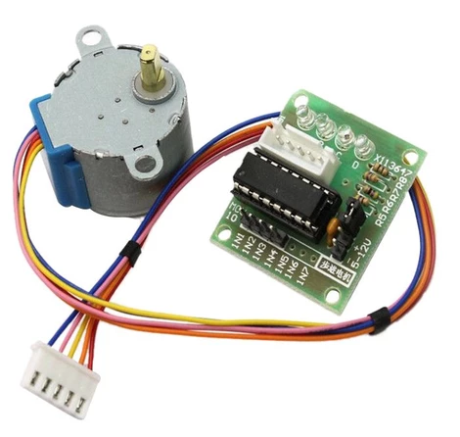
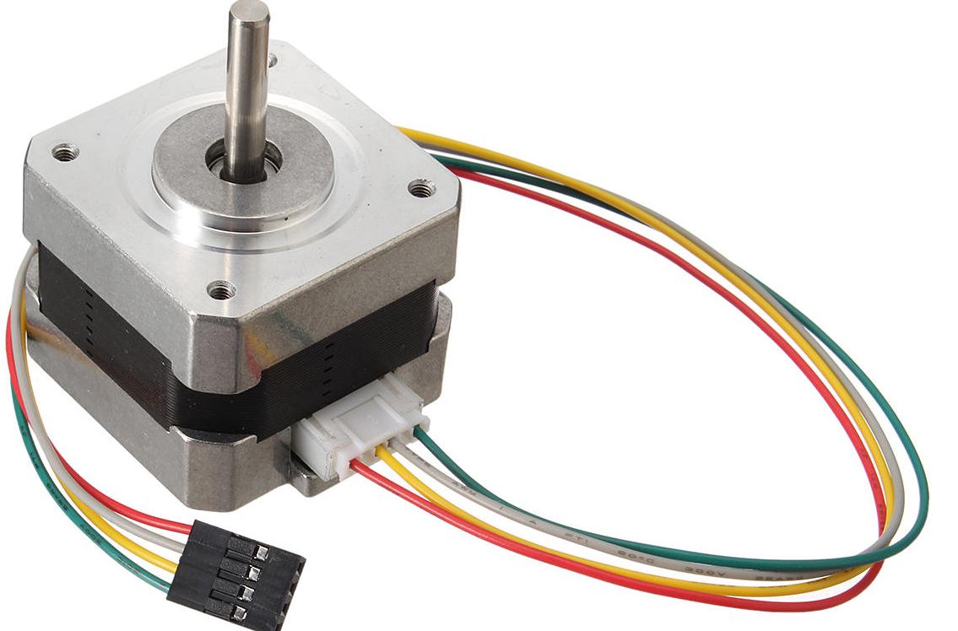
Stepper Motors
Notes:
VIDEO SHOWN

Slide 22
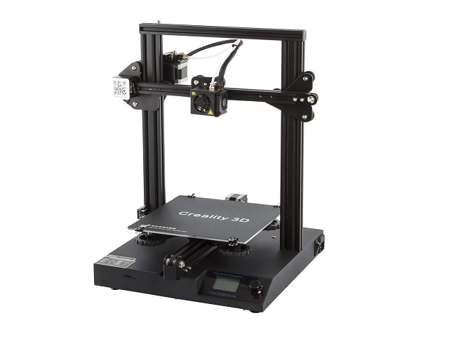
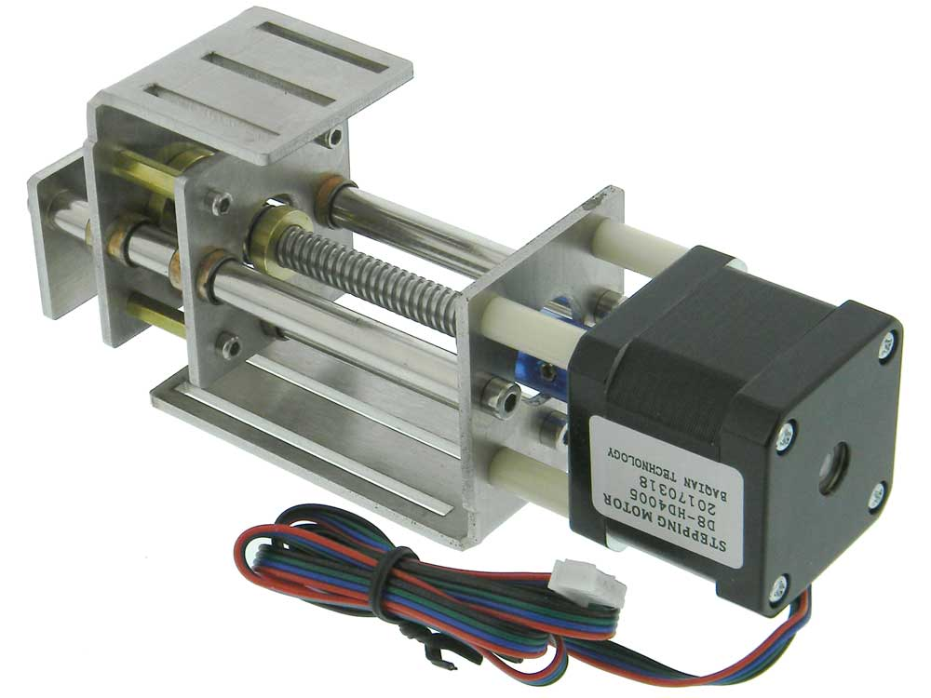

Slide 23
POWER SUPPLY
BATTERIES

Slide 24
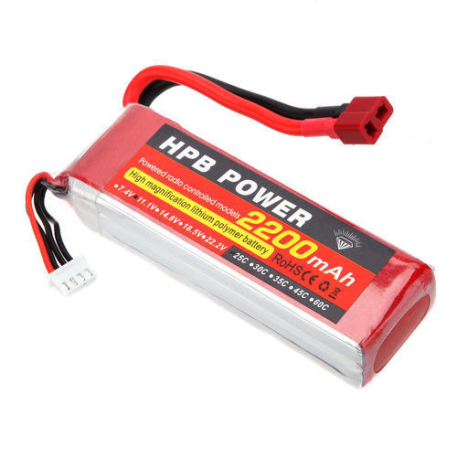
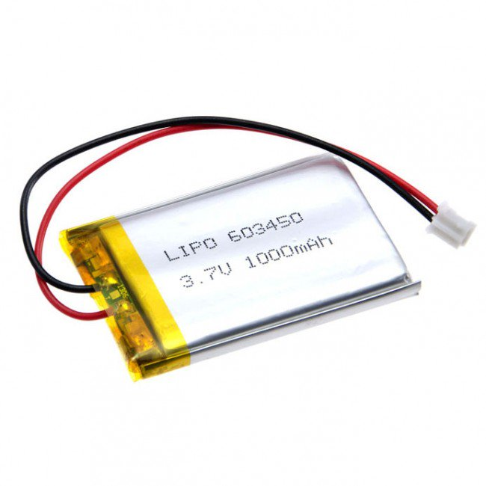
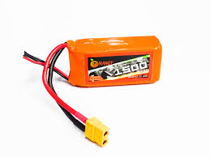
Li-po batteries

Slide 25
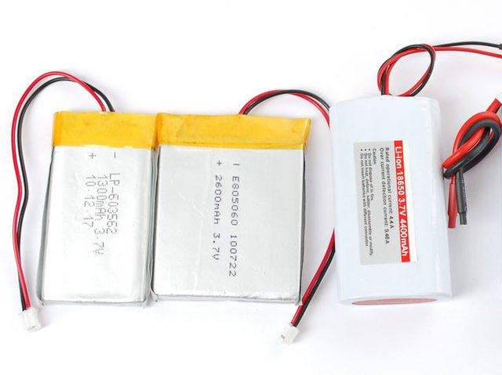
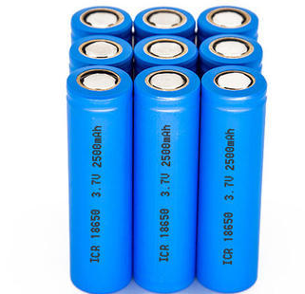
Li-ion batteries
Notes:
18650
2170

Slide 26
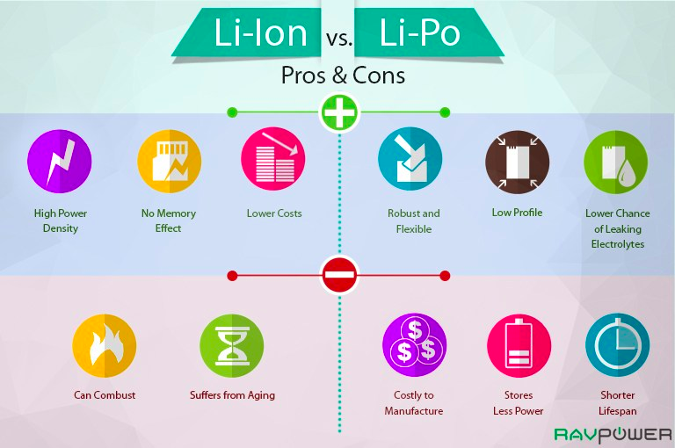
What’s the final pick?

Slide 27
You now have the knowledge required for building a DD bot
👍

Slide 28
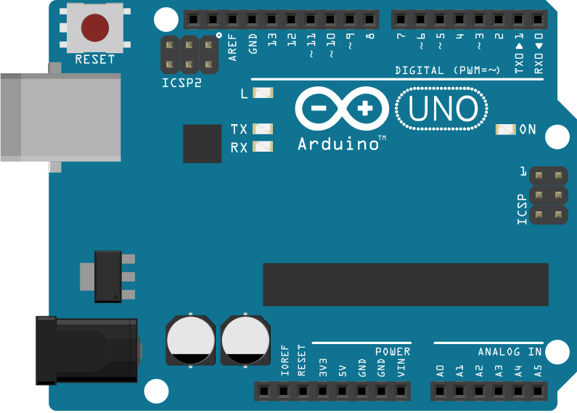
Arduino
Arduino is an open-source platform
Arduino IDE (Integrated Development Environment)

Slide 29
Arduino
What is an Arduino?
Why use Arduino?
Types of arduinos
Pro mini
Nano
Uno
Mega

Slide 30
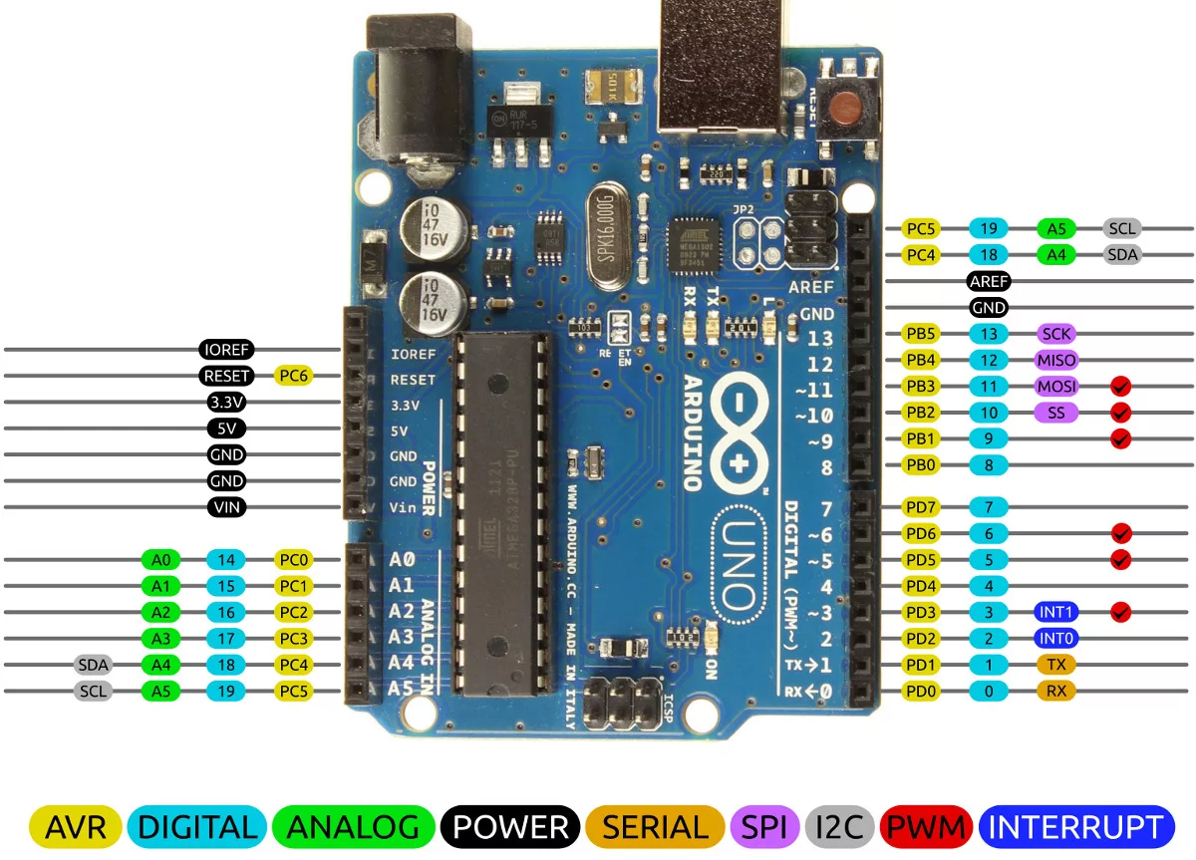

Slide 31
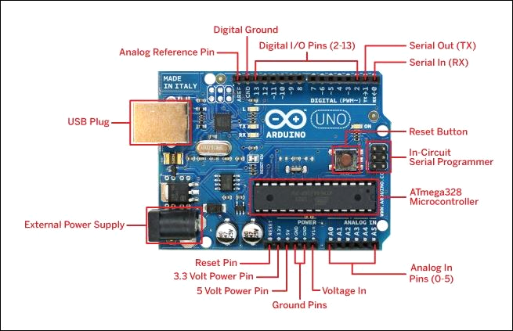

Slide 32
CODING FOR ROBOTICS
BVPIEEE
Computer Society (CS)

Slide 33
Some Programming Concepts
Variables
Data Types
Operators
Loops
Functions

Slide 34
Imp terms
#include<>- is used to include outside libraries in your sketch.
KEYWORD- Keywords are specific reserved words in C each of which has a specific feature associated with it. like if else, switch, class, etc

Slide 35
Variables
A storage place which has some memory allocated to it.
Variables in C/C++ and other typed languages are declared as follows
Data_type variable_name;
Data_type variable_name= some_value;

Slide 36
Operators
Operators are symbols that are used for mathematical,logical operations.
- * / && || == are some examples

Slide 37
Data Types
Data types specifies how much memory a variable will take.
This is important because it will define the range of values the variable can take in a program.
Some sizes:
int : 4 bytes
float : 4 bytes
double : 8 bytes
char : 1 bytes

Slide 38
LOOPS
Loops are statements that run iteratively till a condition is reached.
For eg: do x-1 until x=0.
In many typed languages there are 3 types of loops
For loop :
for ( initialize ; condition ; update )
{
block of code
}

Slide 39
LOOPS (contd..)
While loop :
while(conditional)
{
Block of code
Update statement
}
do-while loop :
do{
Block of code
Update statement
}while( condition );

Slide 40
Functions
A group of statements
We need them because sometimes you need a block of code which is used many times in a program.
So we give these statements a common name and call this name whenever you need it.

Slide 41
It’s time to understand how we will use them

Slide 42
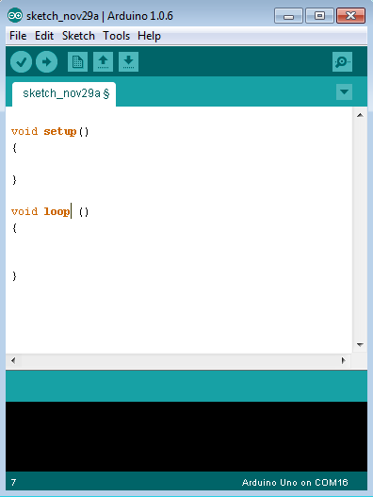
Program Structure
void Setup()
{
. . .
}
void Loop ( )
{
. . .
}
Notes:
Software structure consist of two main functions −
Void Setup()-The setup() function is called to initialize the variables, pin modes, start using libraries, etc.
Void Loop ( ) -After creating a setup() function, which initializes and sets the initial values.

Slide 43
ARDUINO BUILT IN FUNCTIONS
pinMode()
Description - Configures the specified pin.
Syntax - pinMode(pin, mode)
Parameters
pin: the Arduino pin number to set the mode of.
mode: INPUT, OUTPUT, or INPUT_PULLUP.

Slide 44
Example Code
void setup() {
pinMode(13, OUTPUT); // sets the digital pin 13 as output
}
void loop() {
digitalWrite(13, HIGH); // sets the digital pin 13 on
delay(1000); // waits for a second
digitalWrite(13, LOW); // sets the digital pin 13 off
delay(1000); // waits for a second
}

Slide 45
ARDUINO BUILT IN FUNCTIONS
digitalRead()
Description - Reads the value from a specified digital pin, either HIGH or LOW.
Syntax - digitalRead(pin)
Parameters
pin: the Arduino pin number you want to read

Slide 46
Example Code
Sets pin 13 to the same value as pin 7, declared as an input.
int ledPin = 13; // LED connected to digital pin 13
int inPin = 7; // pushbutton connected to digital pin 7
int val = 0; // variable to store the read value
void setup() {
pinMode(ledPin, OUTPUT); // sets the digital pin 13 as output
pinMode(inPin, INPUT); // sets the digital pin 7 as input
}
void loop() {
val = digitalRead(inPin); // read the input pin
digitalWrite(ledPin, val); // sets the LED to the button's value
}

Slide 47
ARDUINO BUILT IN FUNCTIONS
digitalWrite()
Description - Write a HIGH or a LOW value to a digital pin. Its voltage will be set to the corresponding value: 5V (or 3.3V on 3.3V boards) for HIGH, 0V (ground) for LOW.
Syntax - digitalWrite(pin, value)
Parameters
pin: the Arduino pin number.
value: HIGH or LOW.

Slide 48
Example Code
The code makes the digital pin 13 an OUTPUT and toggles it by alternating between HIGH and LOW at one second pace.
void setup() {
pinMode(13, OUTPUT); // sets the digital pin 13 as output
}
void loop() {
digitalWrite(13, HIGH); // sets the digital pin 13 on
delay(1000); // waits for a second
digitalWrite(13, LOW); // sets the digital pin 13 off
delay(1000); // waits for a second
}

Slide 49
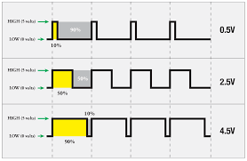
ARDUINO BUILT IN FUNCTIONS
analogRead()
Description - Reads the value from the specified analog pin.
Syntax - analogRead(pin)
Parameters
pin: the name of the analog input pin to read from

Slide 50
Example Code
The code reads the voltage on analogPin and displays it.
int analogPin = A3; // potentiometer connected to analog pin 3
int val = 0; // variable to store the value read
void setup() {
Serial.begin(9600); // setup serial
}
void loop() {
val = analogRead(analogPin); // read the input pin
Serial.println(val); // debug value
}

Slide 51
ARDUINO BUILT IN FUNCTIONS
analogWrite()
Description - Writes an analog value (PWM wave) to a pin. Can be used to light a LED at varying brightnesses or drive a motor at various speeds.
Syntax - analogWrite(pin, value)
Parameters
pin: the Arduino pin to write to. Allowed data types: int.
value: the duty cycle: between 0 (always off) and 255 (always on). Allowed data types: int.

Slide 52
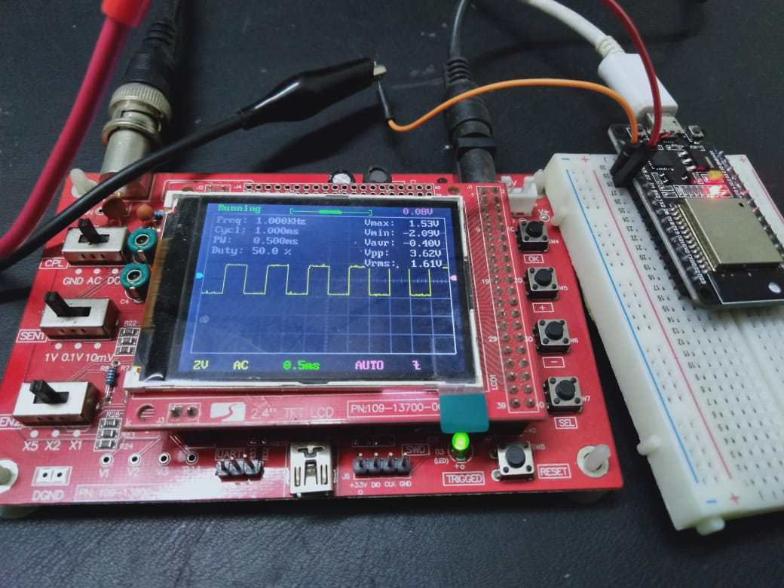
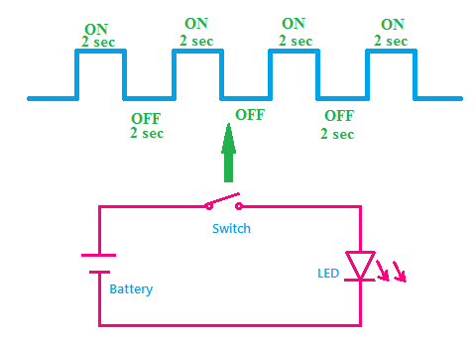
Let’s PWM!!

Slide 53
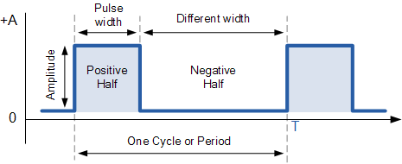
By changing the Pulse Width, we can change the average value of the Voltage in a circuit!

Slide 54
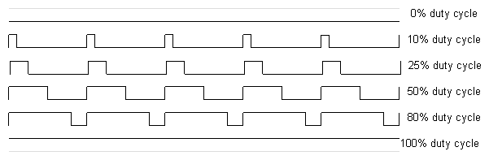
Duty Cycle

Slide 55

Why is it
Important?
Speed
Brightness
etc.
Signal = Information

Slide 56
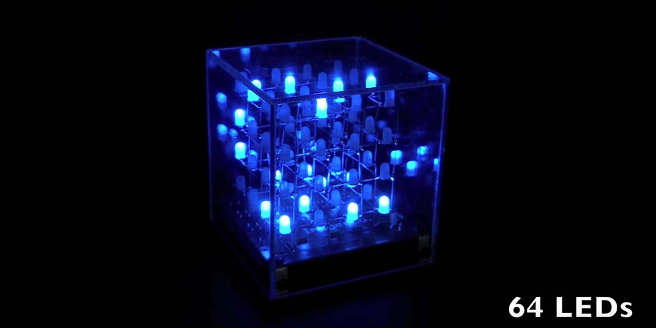
LED cube
What is it?
How does it work?
Is it possible to be made using arduino?

Slide 57
16 LEDs min. No. of pins ?

Slide 59
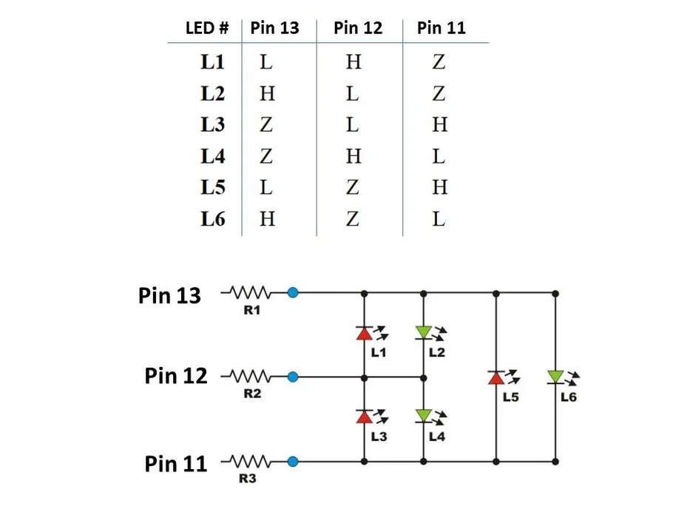
Example of multiplexing
11
5
4
6
3
1
13
2
12

Slide 60
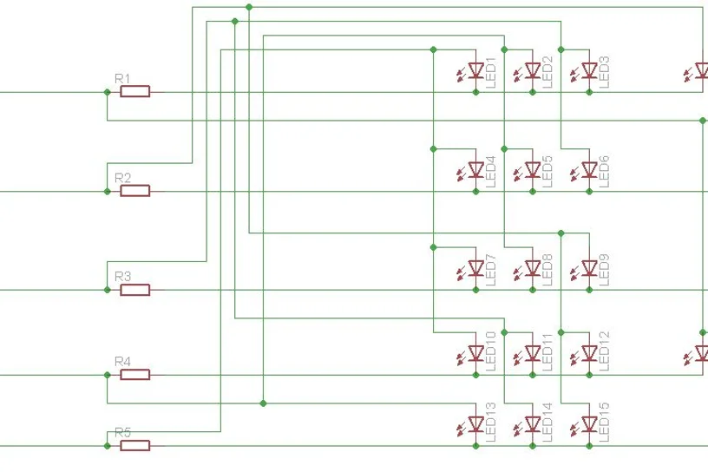
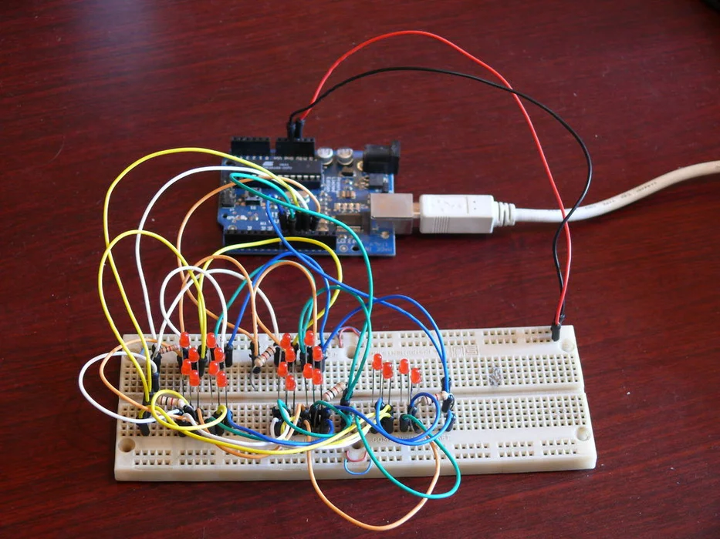

Slide 61
KIT
The real deal

Slide 62
Component | Qty. | DD | Basic | LFR | Complete
Chassis BIG | 1
Wheels BIG | 4
Motors 300RPM. | 4
DPDT | 2
Ribbon wire (unit - meter) | 5
Potentiometer - 10K ohm | 3
LEDs | 30
Servo motor (SG90) | 1
Perfboard | 1
Wire stripper | 1
Single core wire (1 red + 1 black ) | 1
Arduino UNO + Cable (1+1) | 1
Breadboard (Medium size) | 1
Jumper Wires (10 MM,10 MF,10 FF) | 1
Soldering Kit (1 Rod + 1 Solder + 1 Flux ) | 1
IR Sensors | 3
Motor driver L298N | 1
BO Motors | 2
Castor wheel | 1
Chassis (SMALL) | 1
Battery Li-ion 3S 12V | 1
Charger/Adapter 12V | 1
Connector (Barrel jack) | 1
Wheels SMALL | 2
7805 IC - voltage regulator | 2
Relay (Only relay, not module) | 1
Total |  | 1400 | 900 | 1600 | 2900

